Slide 1
Fitbit Tracker Data Analysis
Data visualization using Tableau Desktop
ALIREZA SHIRMOHAMMADIAN

Slide 2
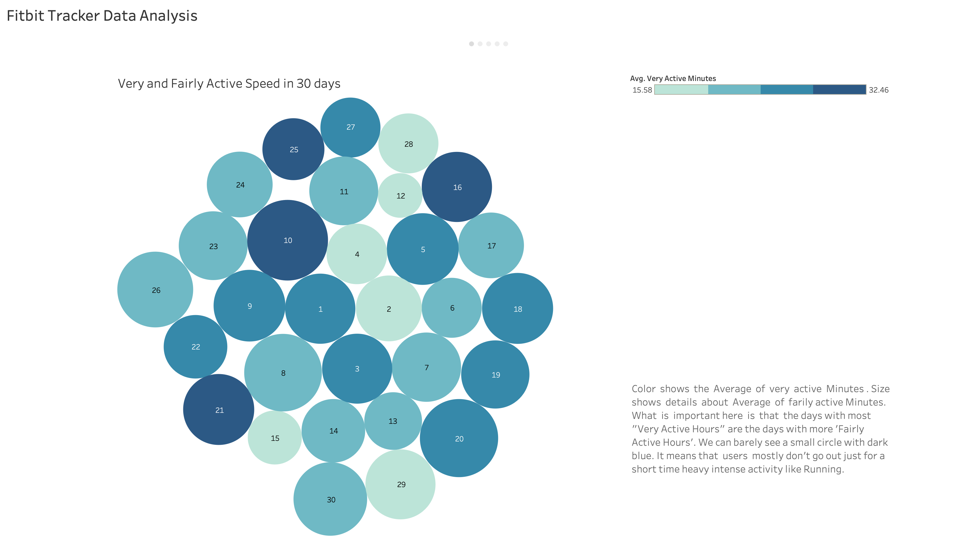

Slide 3
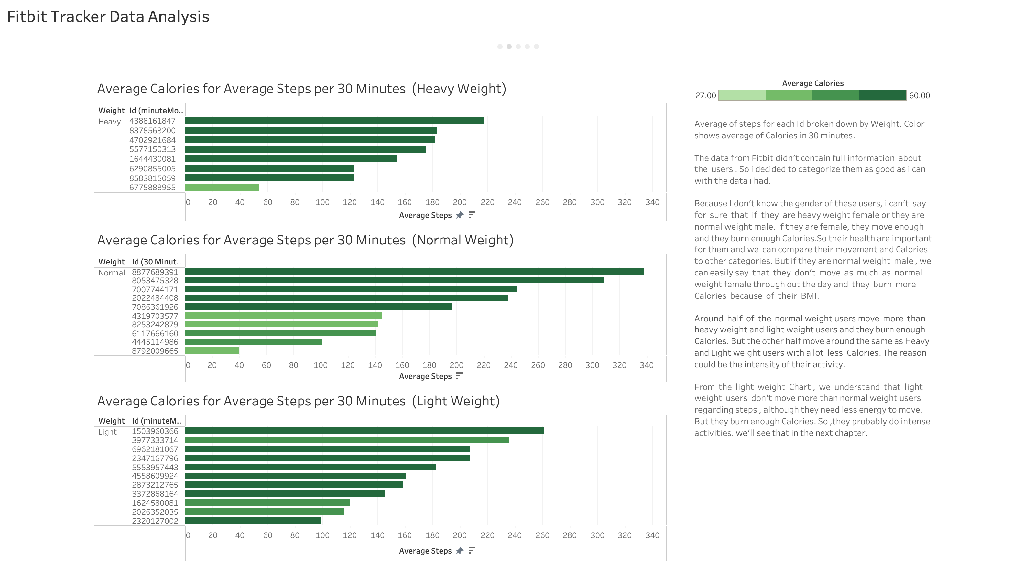

Slide 4
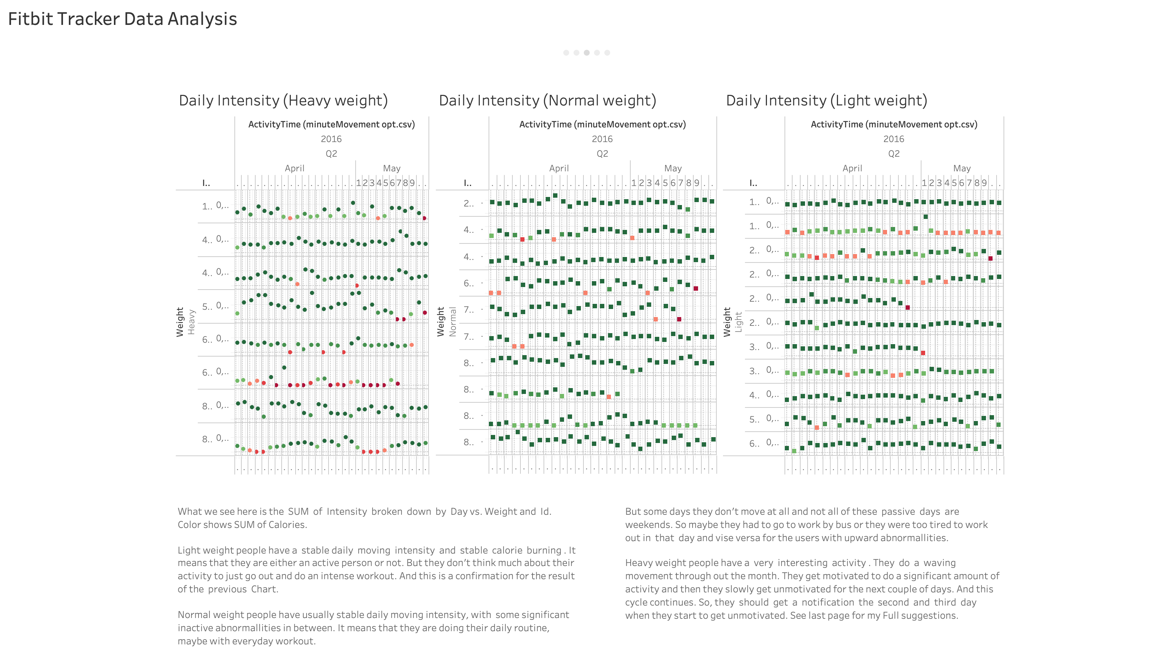

Slide 5
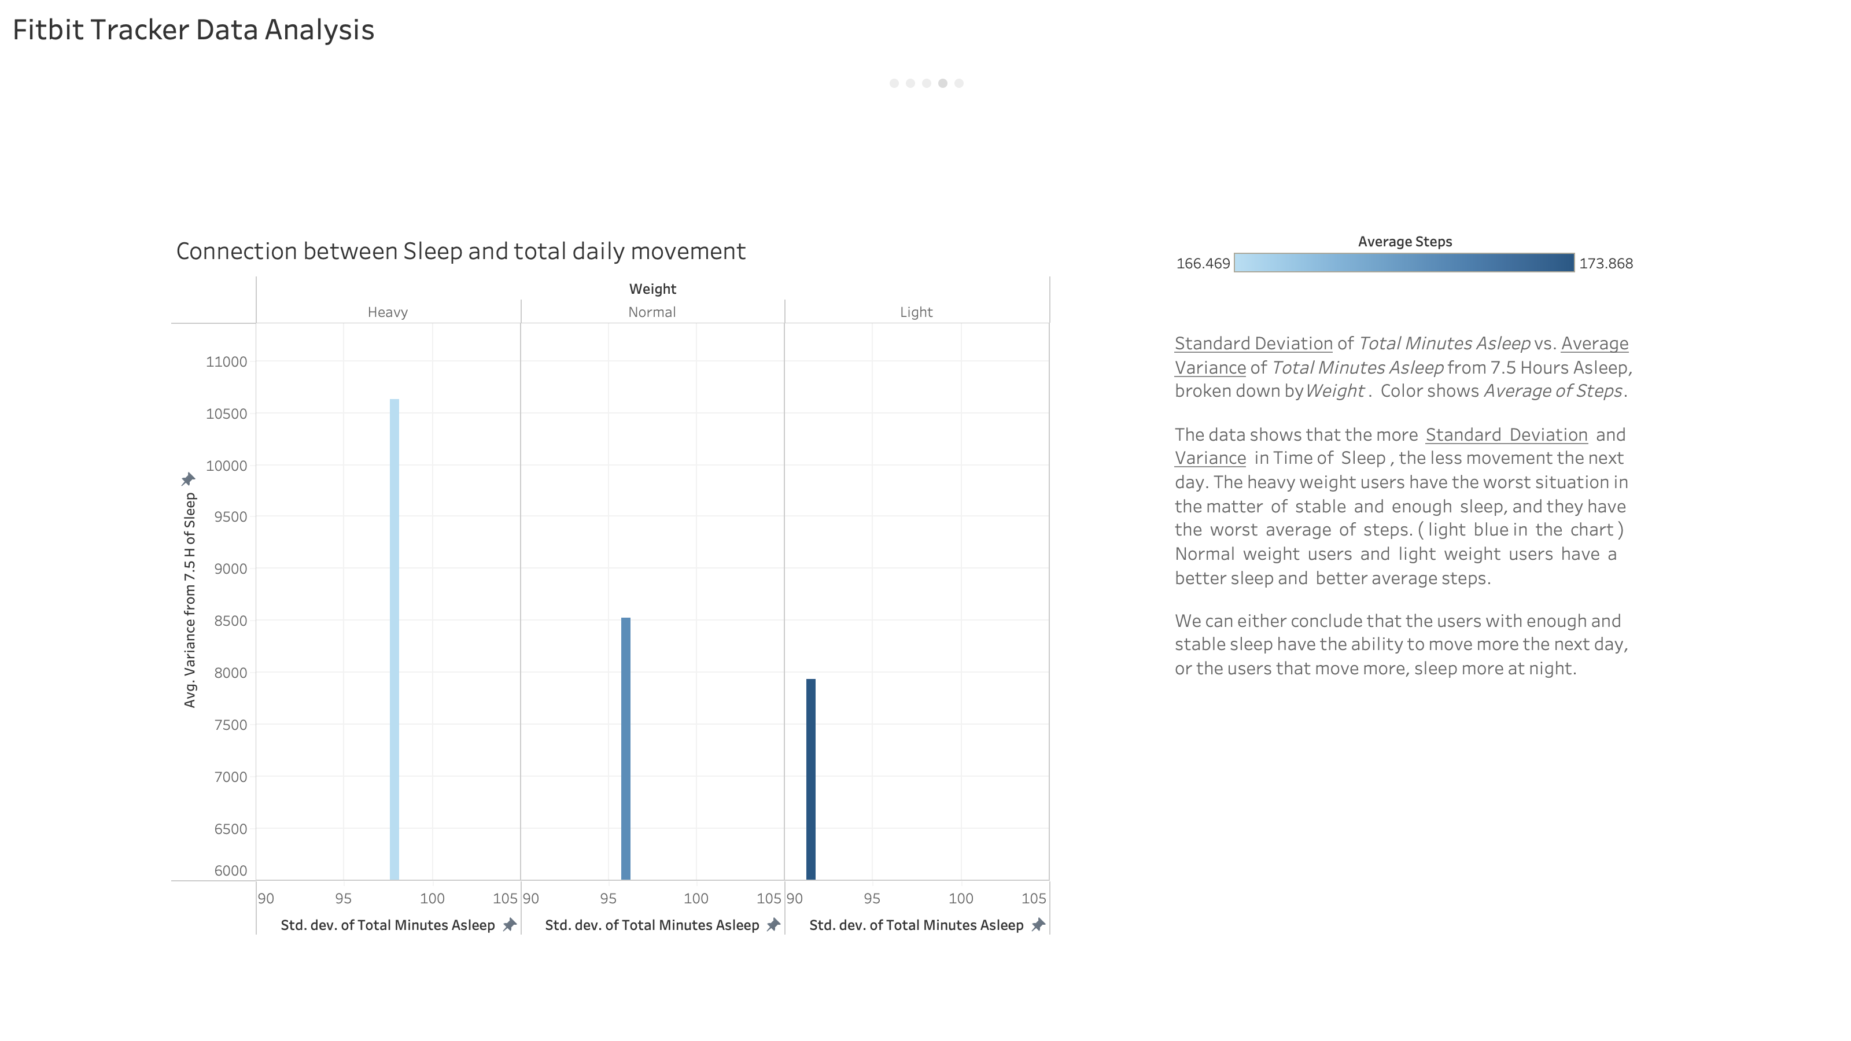

Slide 6
